Slide 1
Second Factor Authentication Keypad
Mohamed Kore

Slide 2
Project Background & Proposal
This hardware component will be a component in a system to track loaned parts in The Parts Crib.
Currently, the parts crib uses a bag system with RFID tags to electronically keep track of loaned items. However, the staff at the Parts Crib are still required to manually verify a students identity by checking their ID and matching their student Number to a request in the System
The Keypad will serve as the second part of a Two-Factor authentication system along with a RFID scanner used for tags on student cards. After a student taps their student card, they input a 5 digit pin code unique to a specific request.

Slide 3
Parts
Nucleo L432KC Development Board
12 Button Matrix Keypad
Raspberry Pi 3 Model B
All components were ordered from Digi-key.
Several soldered Pins became loose and took off the copper around their holes. Had to purchase a second keypad.

Slide 4
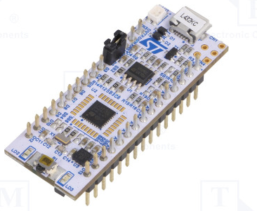
Nucleo L432kc STM32 Nucleo Board
Uses STM32 microcontroller and comes built in ST-LINK
V2 and Arduino Bootloader preloaded.

Slide 5
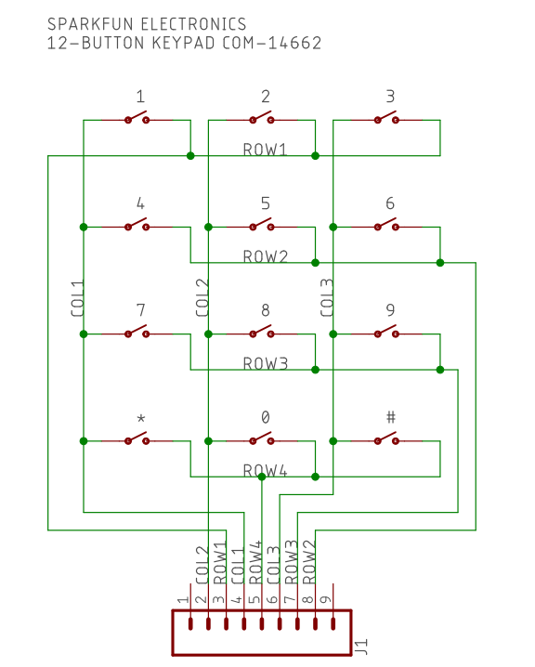
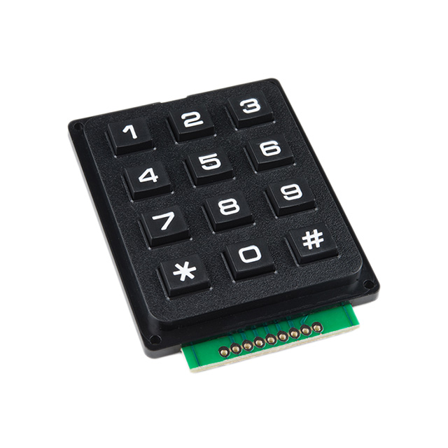
COM-14662 12-Button Keypad

Slide 6
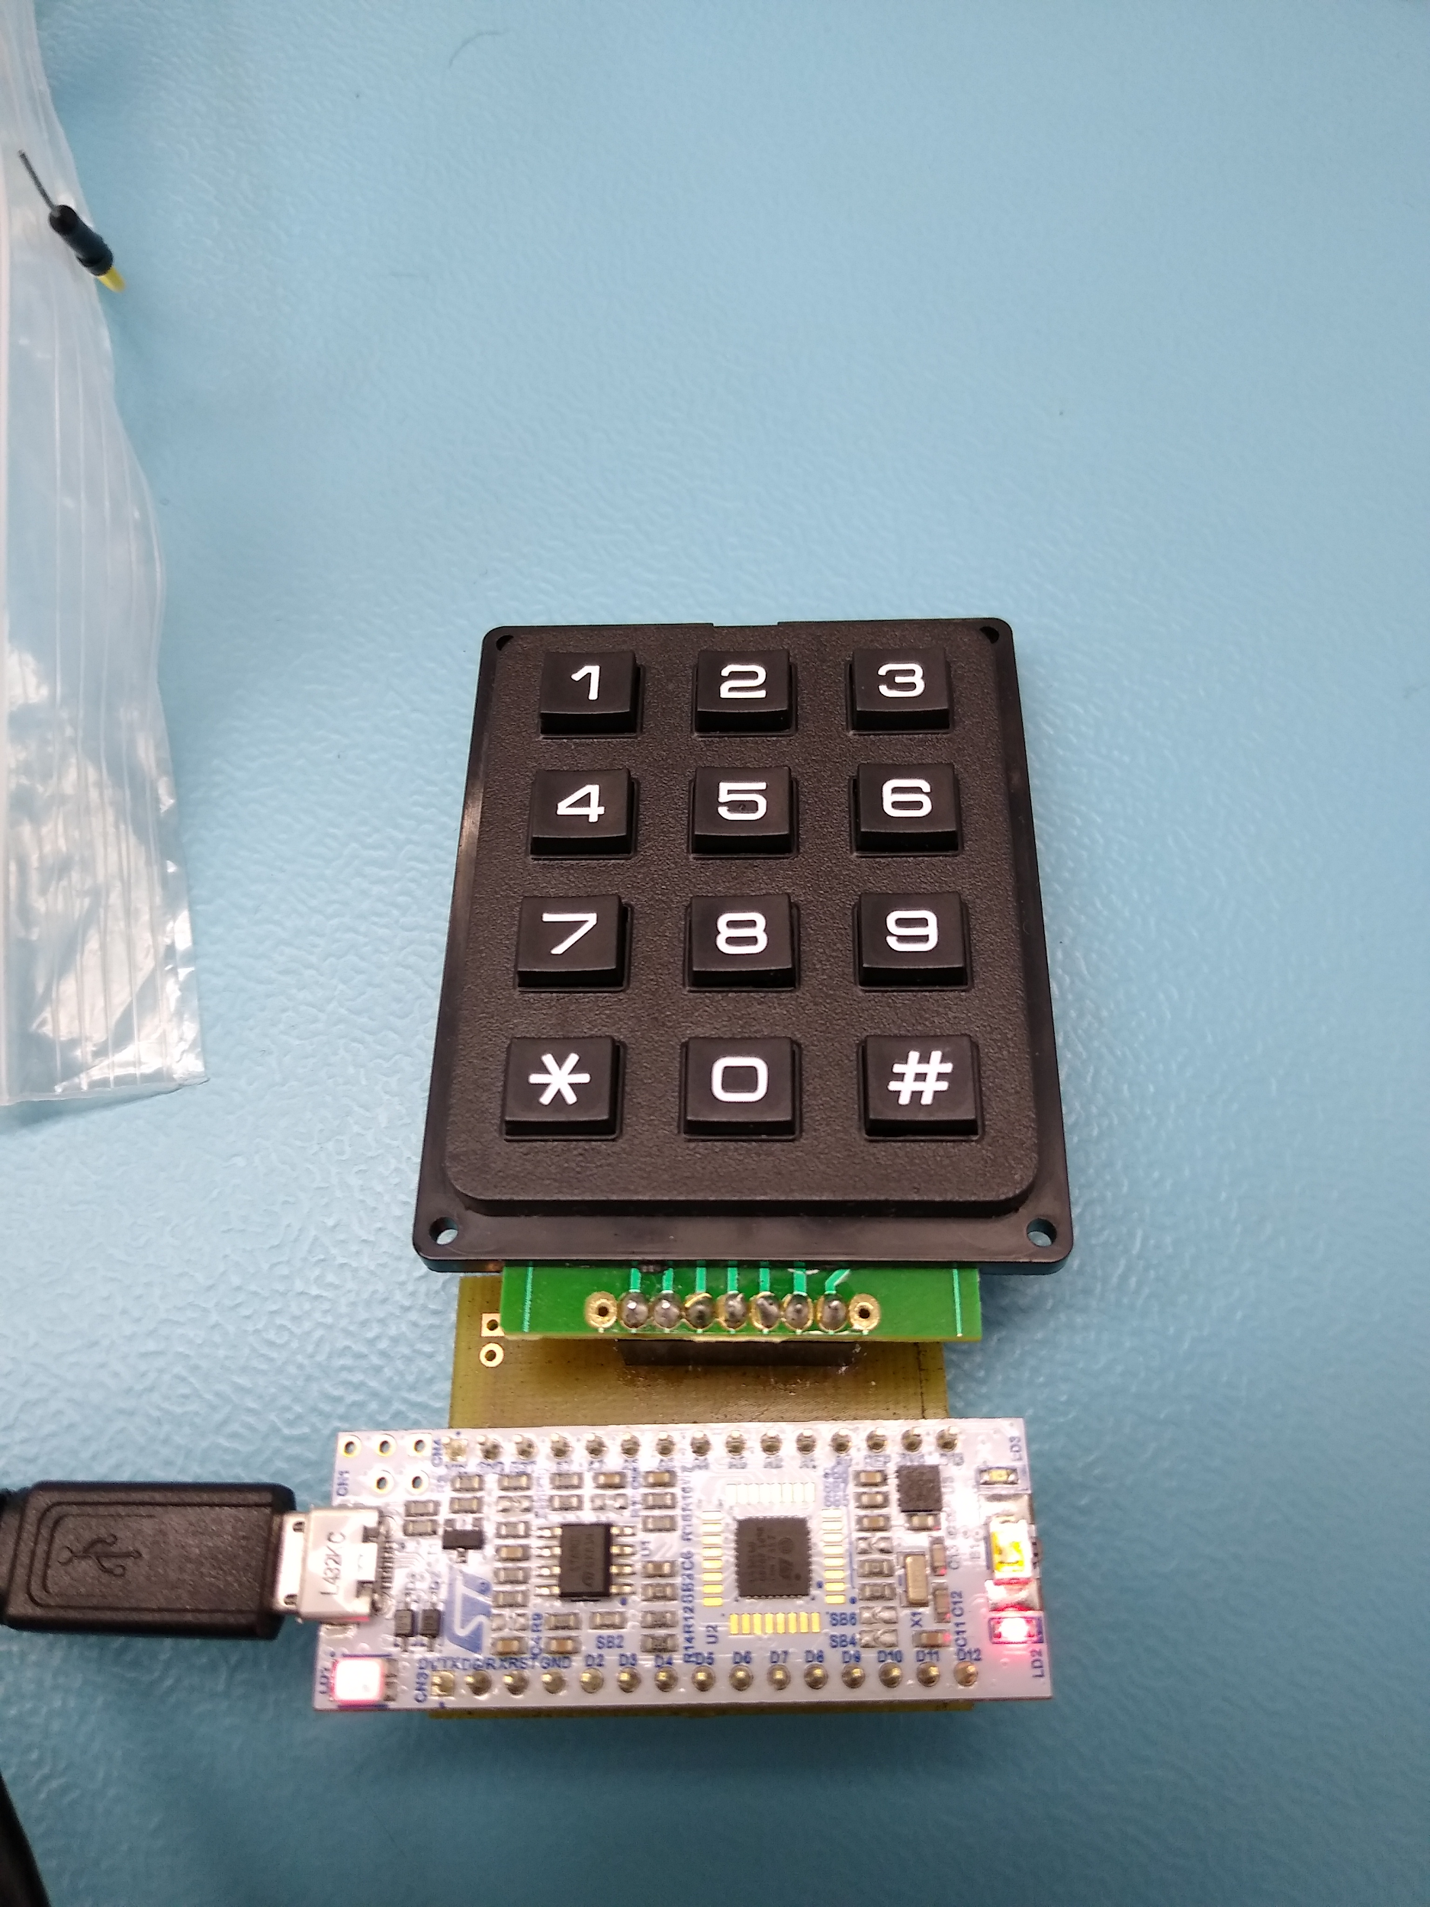
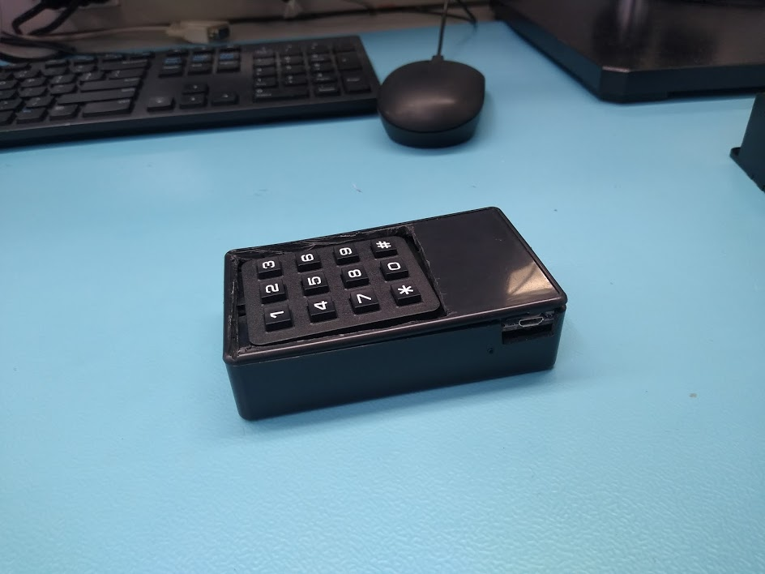
PCB & Enclosure

Slide 7
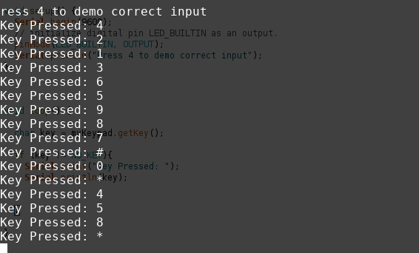
Reading from input

Slide 8
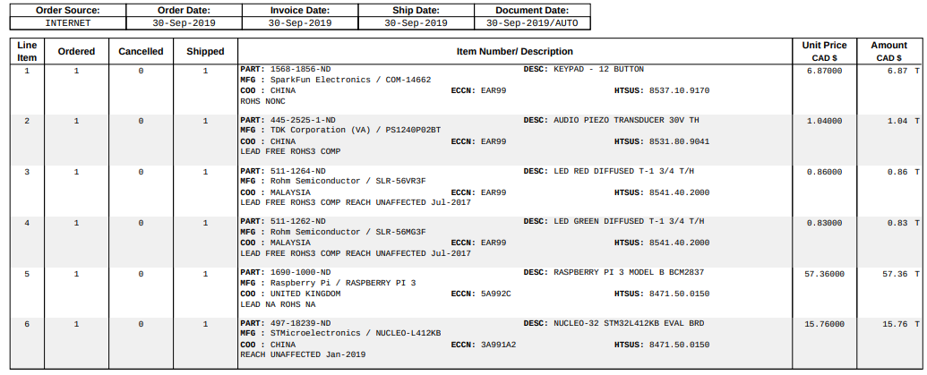
Budget

Slide 9
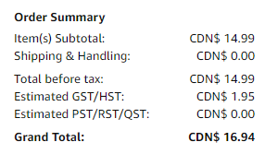
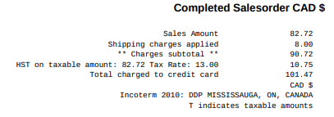
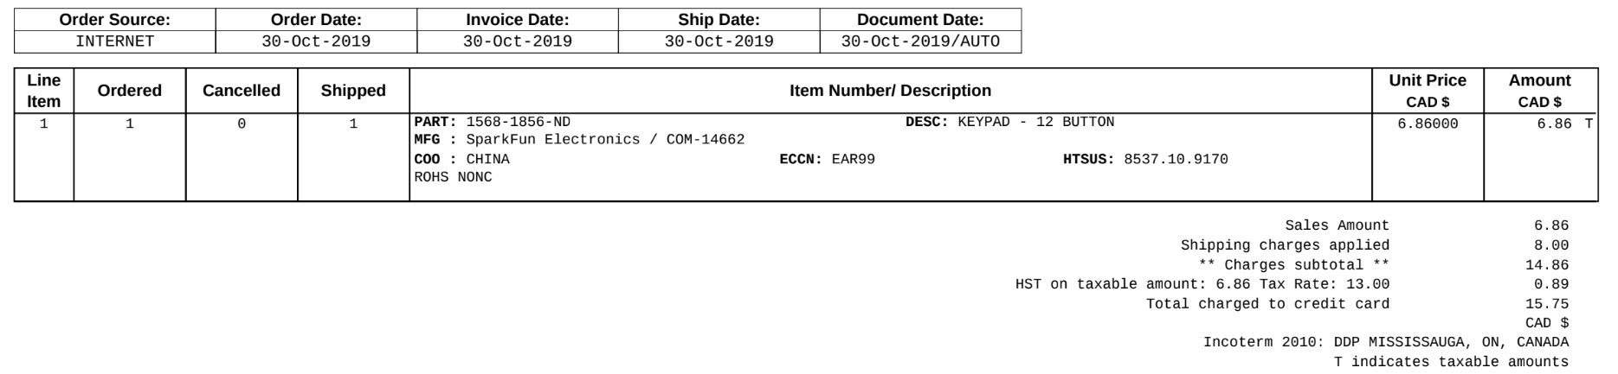
Budget (Cont.d)
Total: CDN$ 134.16

Slide 10
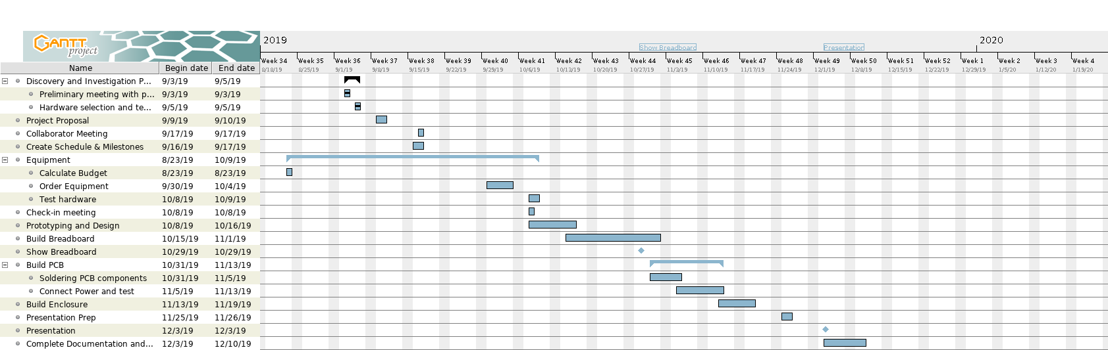
Schedule

Slide 11
Previous Course Knowledge used in Project
CENG 252 (Embedded Systems) + TECH 153 (Technical C) :
C programming (structs for storing keypad configuration) and writing to serial
Linking libraries (used Keypad.h to convert voltage readings from Matrix Keypad to a keypad entry).
TECH 101 Electric Circuits:
Used knowledge of how to test for shorts and open circuits to test and diagnose soldering and wiring issues.
CENG 216 (Intro to Software Engineering):
Produced Gantt Charts for schedule.

